Slide 1
Endpoints Operations
Monthly Operations Summary
JL IT
May 2023

Slide 2
Service Desk Incident Management

Slide 3
Incident Statistics
There are currently 313 open incidents across all teams.

Slide 4
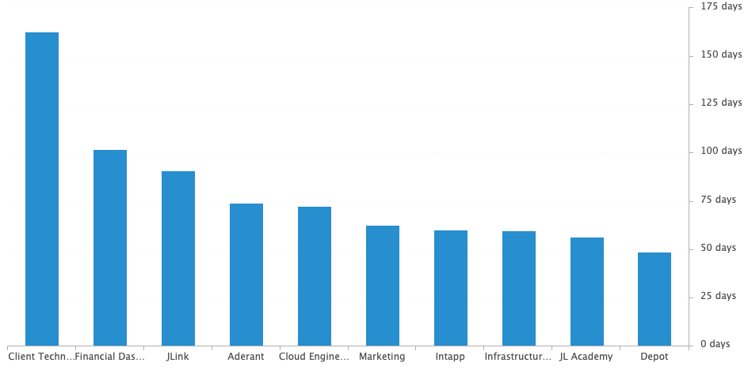
Incident Statistics
Average Age of Open Incidents by Assignment Group - as of the last day of the month

Slide 5
Incident Statistics
Top 5 Subcategories this month:
Microsoft Office (557)
Windows (349)
NetDocuments (277)
Active Directory (174)
Printer (171)
Top 5 Resolved By this month:
(highest volume of resolved Incidents)
Dan (528)
Stephane (319)
Chris (284)
Brandon (274)
Blaise (252)
Survey Response Comment Highlights:
Sandy – “My experiences with the Service Desk has always been the same - excellent. First, they always answer. the phone Second, they always resolve my problem and third, they are extremely patient with me.”
“Blaise is the absolute best at solving problems in an expedited manner! He never hesitates nor does he have to escalate issues up the ladder. JL Houston is so fortunate to have him in our office.”
Dan – “The individuals helping me were fantastic.”
“Brandon is very helpful!”
Stephane – “Don't change. Everything is working great.”
Chris – “Good Service.”
Chris – “Everyone in IT that I have ever dealt with has gotten my problem fixed immediately - I so appreciate JL's IT people!”
“Dan Hall is the best!”
Sandy – “After calling the Help Desk, I was back online and good to go in no time. Thanks so much!”
Erica – “They resolved my issue promptly without any issues.”

Slide 6
Top 10 Customers
@Dan, example: Olga Bello (23): Olga contacted us for assistance with removing her delegate access to multiple attorneys, install Scansnap, for Teams Meeting errors, for her account being locked out, confusion around time zone for a meeting, password protecting a file, issues with external monitors, issues printing, saving emails to ND, VESA rights, an ND Check-in error, creating a batch of zip files (x2), issues with scaling in Chrome, an error in Power PDF, and general assistance with Outlook (x4).
Molly Ryan (31):
Beth Davis (28):
Katessa Charles (21):
Nancy Batchelder (20):
Kyle Woodward (19):

Slide 7
Top 10 Customers cont.
6. Cora Wilke (15): Cora contacted us for assistance with
Nichole Villa (15):
Ann Rake (14):
Cheryl Sturgess (14):
Joyce Buller (14):

Slide 8
Problem Statistics
Open Problems
Problem | Date of most recent update | Assignment Group
PRB0010189 | 2023-05-24 | Cloud Engineering
PRB0010587 | 2023-01-12 | Cloud Engineering
PRB0010598 | 2023-03-28 | Security
PRB0010657 | 2023-05-03 | Cloud Engineering
PRB0010678 | 2023-03-16 | Client Technology
PRB0010679 | 2023-03-17 | Cloud Engineering
PRB0010680 | 2023-05-31 | Cloud Engineering
PRB0010700 | 2023-04-10 | Infrastructure Engineering
PRB0010715 | 2023-05-15 | Access
PRB0010753 | 2023-06-02 | Cloud Engineering
PRB0010755 | 2023-06-05 | Cloud Engineering
Problems in red have not been updated within the last month.

Slide 9
Update & Reminder Highlights
8x8 w/New Hires: New hires starting on/after May 15th will be setup with a soft phone (Teams/8x8) instead of with a Cisco phone. This will happen no matter if their office has migrated or not.
Template in Incidents: “Username” template was added for use with calls asking for their username, or questions around why this is needed after the CIS policy rollout.
Physical Phones: To make sure we’re all on the same page about physical phones, these are not available to order or request. Users may not request a physical phone via the Service Catalog or via Incident. The new hire onboarding form does not give the option to order a physical phone either.
There will however be an option within the onboarding form to order a physical phone if a user’s title is receptionist or legal secretary.
Please be sure to explain, “Physical phones are only being given to legal assistants and receptionists and this decision was made by firm management.”
For now, if a user pushes back and wants this escalated, please let them know you’ll escalate to your manager and assign the incident to me. I’ll call them back and discuss. If needed I’ll escalate this to firm management and they can make a final decision.
Outbound calls: Remember that when dialing from Teams dial pad/8x8 the “9” is not needed. Just area code and phone number (1+###-###-####).
Printer Toner: There is an ongoing issue with our toner supplier and Office Administrators have been contacted by Facilities, asking that they purchase toner from other vendors for now (Staples, Amazon, etc.). If a user reaches out to us about there not being available toner on-site for their printer, please direct them to contact their OA to order it.
Escalation Guide: The escalation guide has been updated to reflect the above category changes as well as some of the recent additions that were missed. This list once again matches up with the incident table and has a listing of where these newer items should be escalated.
Notes:
Some highlights from the month’s U&R emails are listed here.
One to two emails are sent a week to the Service Desk reminding them, or updating them on, changes to existing workflows or policies. Quick notes sent via Teams are also rolled up into these emails to be sure that these points are not missed. All U&R emails are listed in Confluence for reference by other teams.

Slide 10
Technology Operations

Slide 11
Escalation Status

Slide 12
Logic Monitor Alerts
Critical Alerts:
Majority of critical was due to JL-Mimecast-E01 consuming resources on the VM and the host it resides.
Idle Interval ( no response back from LM)
Error Alerts:
AvailabilityStateErrorAlert – Citrix Virtual Desktops in Azure
Physical Blade Servers State due to mimecast VM max out resources

Slide 13
Resource Uptime
Resource | March | April | May
Aderant | 99.973% | 99.979% | 99.996%
Intapp Walls | 100% | 100% | 99.997%
JL - Home | 96.77% | 96.996% | 99.981%
JLink | 99.98% | 99.996% | 99.992%
NBI | 96.751% | 99.989% | 99.974%
Payments Credit Card | 100% | 100% | 99.98%
Dashboard | 99.989% | 100% | 100%
Biscom | 98.756% | 99.973% | 99.998%
Citrix | 99.998% | 99.991% | 99.981%
VPN East | 99.997% | 99.969% | 99.992%
VPN West | 100% | 99.981% | 99.984%
Logic Monitor Collector Polling
Adjusted status code JL - Home
Consistent SLA from previous month

Slide 14
Endpoint Engineering

Slide 15
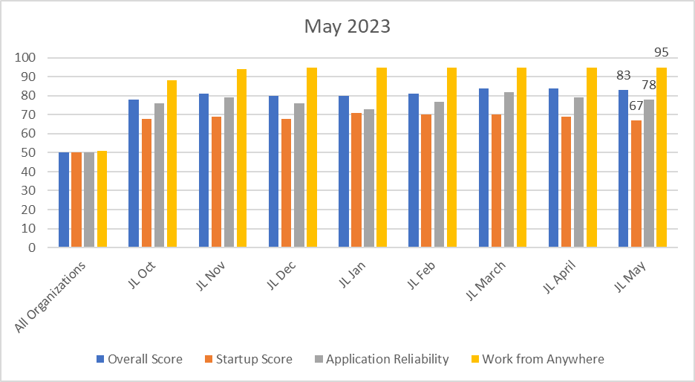
May 2023
Overall score fell one to 83 mainly due to expedited updates pushed in May to remedy critical vulnerabilities. App Reliability score fell to 78(-1) primarily due to multiple deployments beginning to move through to prod.
Startup score fell slightly to 67(-1) due to the above efforts to expedite updates/apps throughout our fleet. We expect this number to rise once fully in prod and removal of aging hardware.

Slide 16
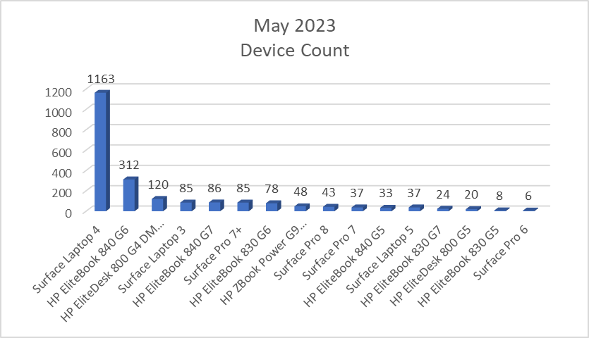
Endpoint Model Inventory
1163 (+7 units in May) total Surface Laptop 4s – Best overall performer.
6 remaining Surface Pro 6s (-2 unit since May) - Worst performer overall.
Surface Laptop 5s(+8 since May) continue to replace aging hardware and boost our Core Sign scores as this is the best model in this category.

Slide 17
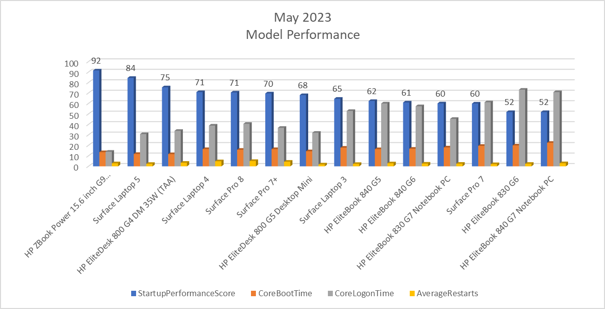
Endpoint Model Performance
Introducing more SLT5's to our fleet while removing aged devices helps keep our Performance scores climbing upwards. HP G6s and G7s, who are decreasing in numbers, are our worst performers for Boot Time and Core Logon scores.

